Slide 1
Weather Maps
Presented by Kesler Science
Notes:
Created by Kesler Science – More 5E lessons at KeslerScience.com

Slide 2
Essential Questions:
How can you use weather maps to explain global weather patterns and their influence on local weather?
How can you interpret high and low pressure areas as well as fronts on a weather map?

Slide 3
Weather Maps
Atmospheric(Air)Pressure
Pressure caused by the weight of air above an area
Pressure decreases with increasing height above Earth
A 1 square inch column of air measured from sea level to the top of the atmosphere weighs approximately 14.7 pounds
1 sq. in.
column of air
Gravity
14.7 lbs

Slide 4
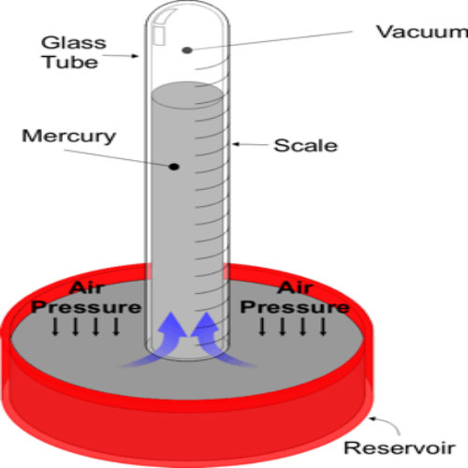
Weather Maps
Mercury Barometer
Air Pressure
Measured with a barometer in millibars.
Average barometric pressure at sea level is 1013.25 millibars or 29.92 Hg (inches of mercury)
High pressure –creates greater pressure on the barometer
Low pressure - creates less pressure on the barometer

Slide 5
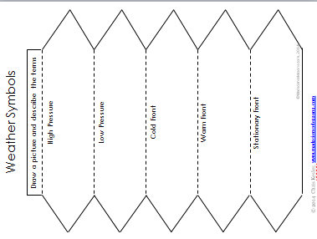
Quick Action – INB Template
Title INB Template
Cut out the Template
Glue into notebook along narrow tab.
Draw and color a picture of the symbol and describe the weather associated with it.

Slide 6
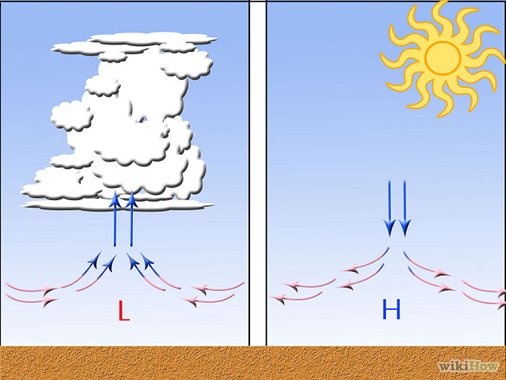
Weather Maps
High pressure H
As air cools, it becomes more dense and sinks toward the Earth’s surface spinning clockwise.
Low pressure L
As air warms, it becomes less dense and rises above the Earth’s surface spinning counterclockwise.

Slide 7
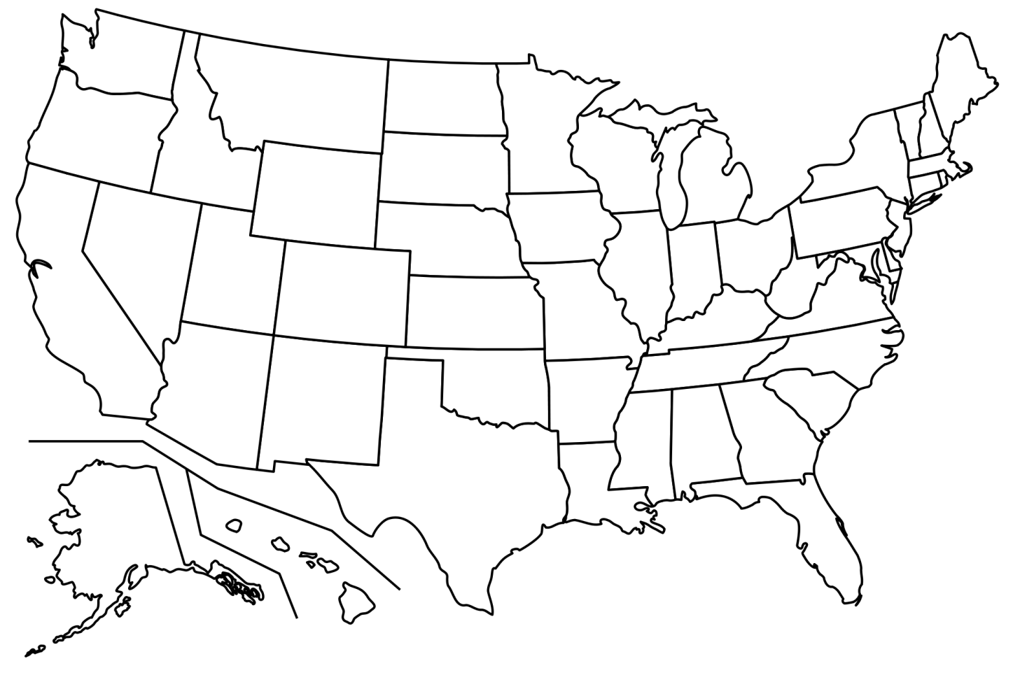
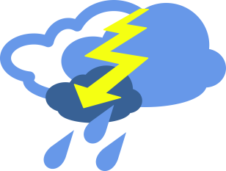
Weather Maps
High Pressure
Sunny, clear skies
Calm winds, spiral clockwise
Cool, dry air
Higher than normal - 30.5 Hg
Low Pressure
Cloudy, stormy skies
Strong winds, spiral
counterclockwise
Warm, moist air
Lower than normal - 28.9Hg
What weather occurs when a high pressure system moves into your area ?
H
L

Slide 8
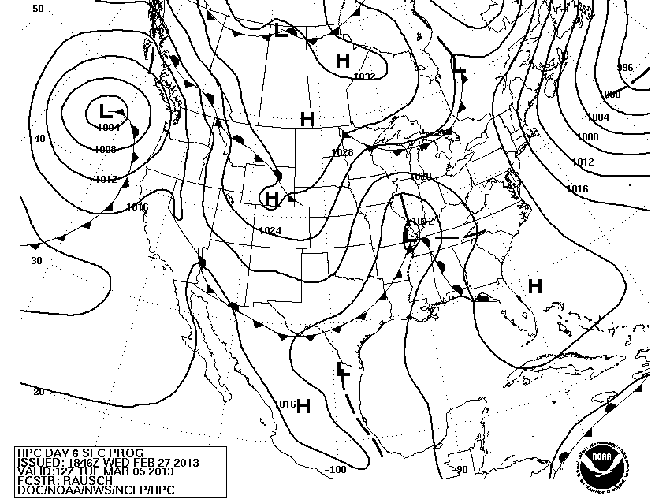
Weather Maps
Isobars
A line connecting points of equal atmospheric pressure.
Measured in millibars - mb
One millibars is equal to about .02953 inches of mercury.

Slide 9
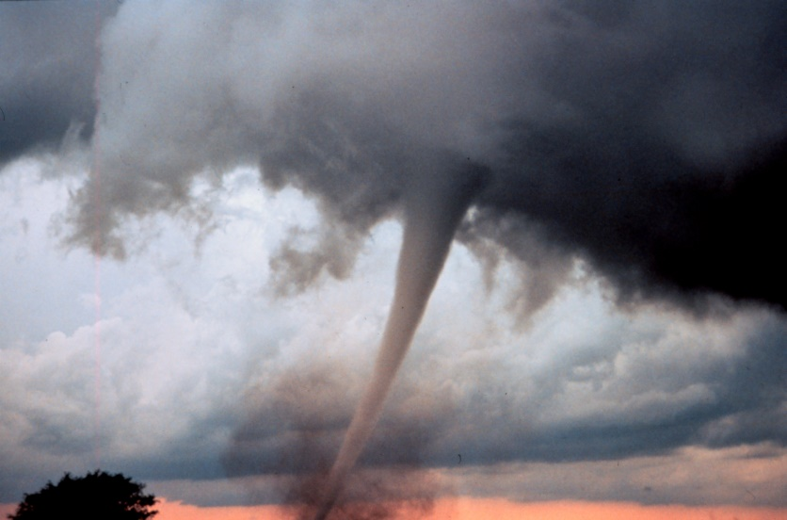
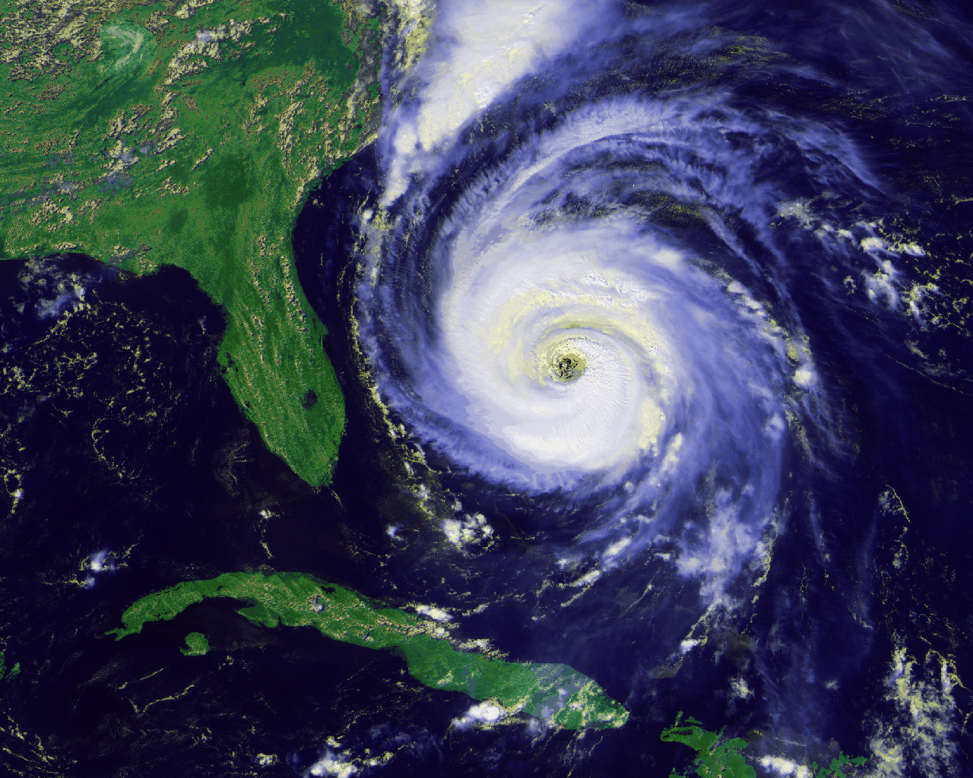
Weather Maps
Low Pressure in Storms
Tornados Hurricanes
850 mb, 25.17 Hg 882 mb, 26.05 Hg
Possibly lowest ever recorded Lowest U.S. storm measured
Notes:
The lowest hurricane pressure on record was not long ago, Hurricane Wilma in 2005 had a central pressure of 882 mb!!!!

Slide 10
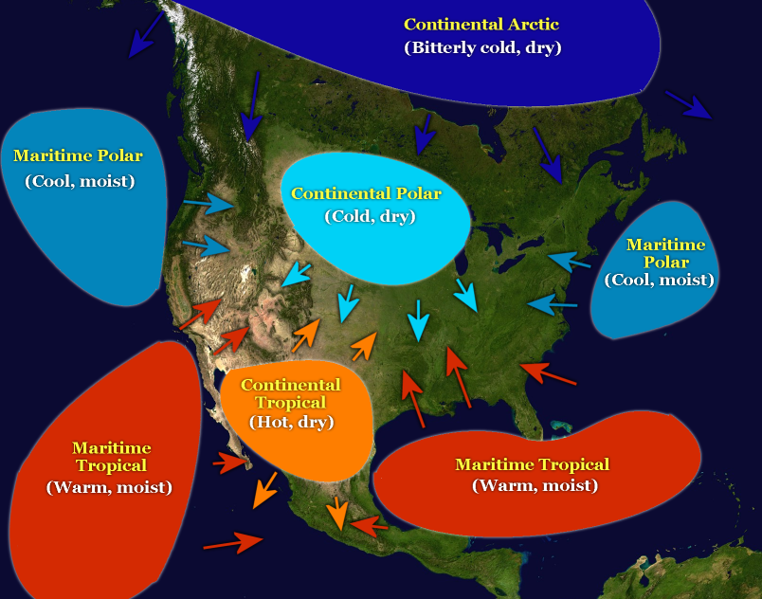
Weather Maps
Air Masses
A large body of air that has relatively uniform temperature and humidity.
Originate
over land (Continental)
over water (Maritime).
Cold air masses tend to approach from N, NW or W.
Warm air masses tend to approach from S, SE or E.

Slide 11
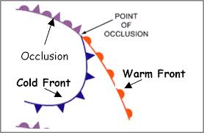
Weather Maps
H
L
Frontal Movement
Cooler air masses (H) are more dense and flows toward areas that are less dense, warm, and moist. (L).
High pressure areas move into low pressure areas.
q

Slide 12
Weather Maps
Front
The boundary between two air masses.
Classified by which type of air mass (cold or warm) is replacing the other.
Map symbols point in direction front is moving.
Cold
Warm
Stationary
Occluded

Slide 13
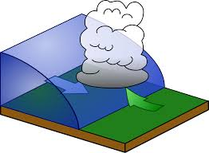
Weather Maps
Cold Front
A cold air mass is replacing a warm air mass.
Air behind the front is colder and drier.
Pressure increases (H)
Moist air is pushed up over the cold air.
Showers and thunderstorms form along leading edge of front.

Slide 14
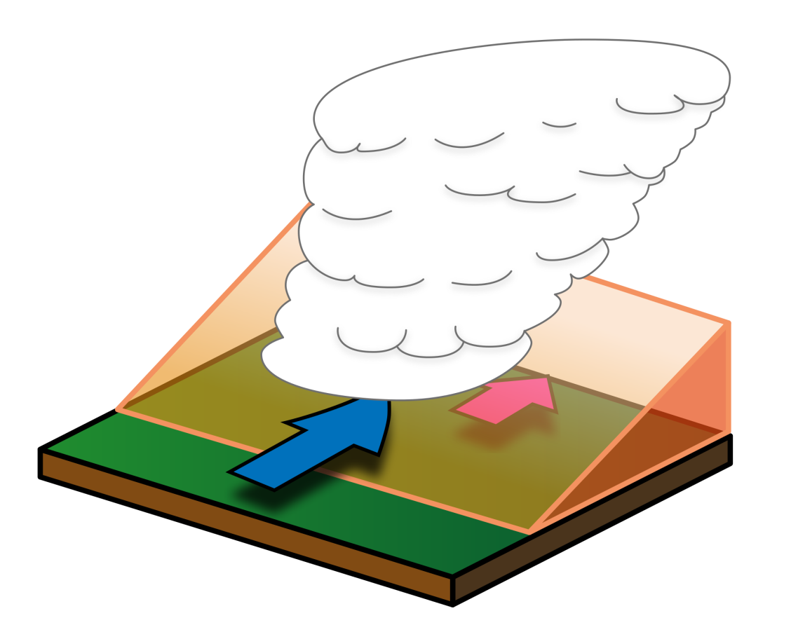
Weather Maps
Warm Front
A warm air mass is replacing a cold air mass.
Air behind the front is warm and moist.
Pressure goes down (L)
Slow moving, gradual rise of warm air over cold air.
Widespread, continuous precipitation occurs along and ahead of the front.

Slide 15
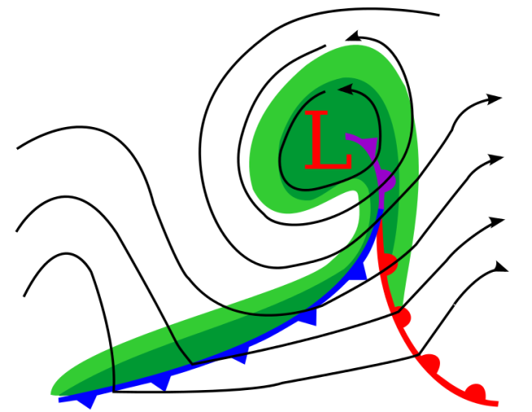
Quick Action – Weather Maps
Write About
Write a quick description of a cold and warm front.
Explain what the weather would be before, during and after the frontal passage over your city.

Slide 16
Weather Maps
Stationary Front
A boundary between two different air masses, neither of which is strong enough to replace the other.
Light rain over several days

Slide 17
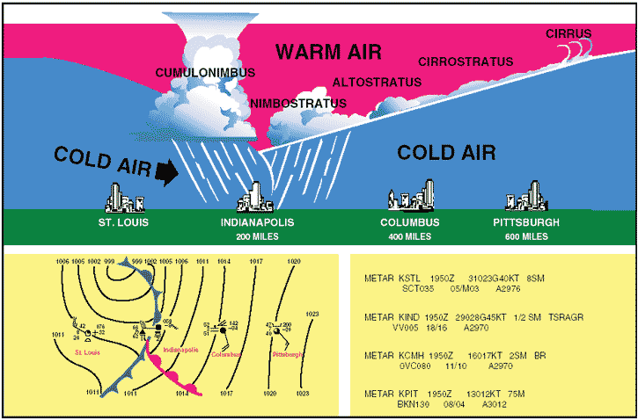
Weather Maps
Occluded Front
Two cold air masses converge on a warm air mass.
Occurs when a fast moving cold front overtakes a warm front pushing it up and over cold air.
Thundershowers form along the front.
After frontal passage the sky is usually clear and dry.

Slide 18
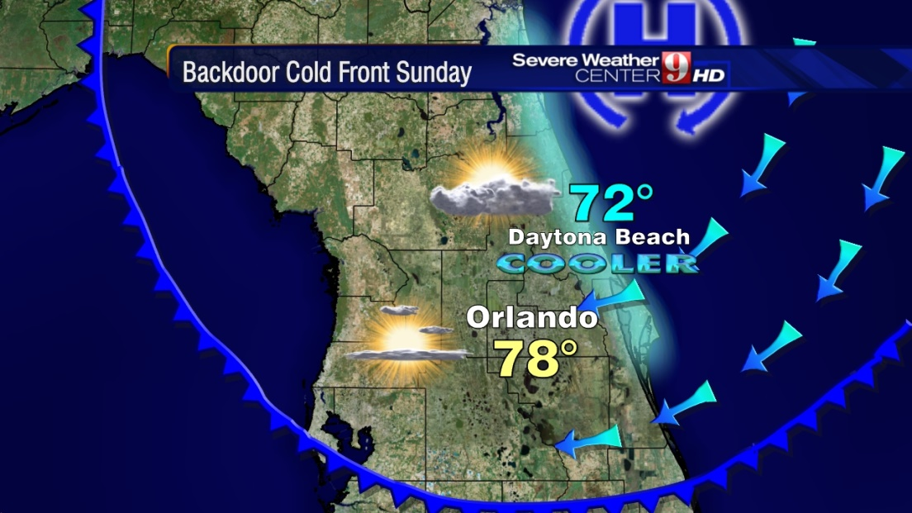
Weather Maps
Back Door Cold Front
Approaches from the east or northeast.
The term “back door” is most commonly used in the northeast U.S. when cool Atlantic maritime air moves in from the east and replaces warmer continental air.

Slide 19
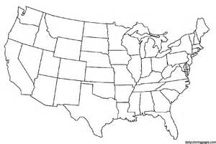
Quick Action – Title
Stand up and find a partner.
Discuss what this map shows you.
Decide where you would draw in a fontal boundary.
Explain where and what type boundary it should be.
Describe the weather on both sides of the front.
H
L
35º
39º
39º
75º
40º
75º
80º
45º
70º

Slide 20
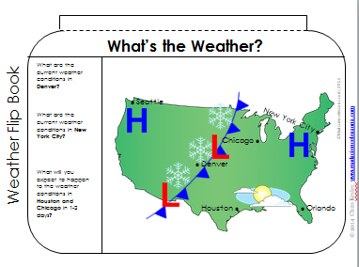
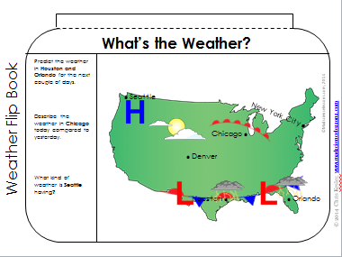
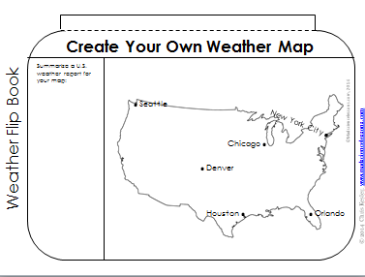
Quick Action – INB Template
Title INB Template
Cut out the Templates.
Glue along the narrow tabs to make a flip book.
Answer the questions and create your own map.

Slide 21
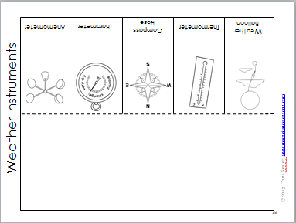
Quick Action – INB Template
Title INB Template
Cut out the Template
Glue on back of blank side.
Makes a flip book.
Define each instrument under flap.

Slide 22
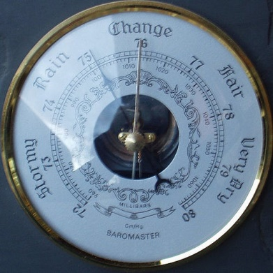
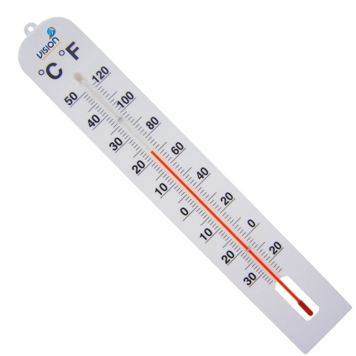
Weather Maps
Weather Instruments
Barometer (A) - measures atmospheric pressure in mb & Hg
Anemometer (B) - measures wind speed in mph
Thermometer (C) - measures temperature in ºC & ºF
A
B
C

Slide 23
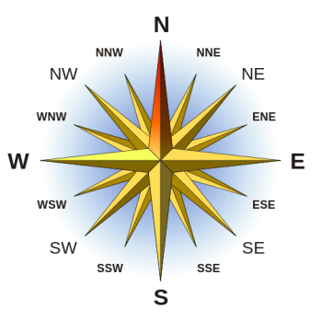
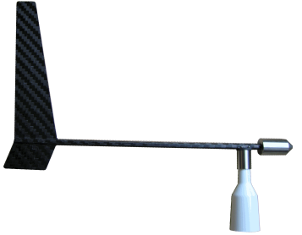
Weather Maps
Weather Instruments
Weather Balloon (A) - carry instruments to high altitudes to measure pressure, temperature, humidity, and wind speed
Compass Rose (B) - helps determine wind direction when reading weather maps
Wind Vane (C) - measures wind direction as N,S,E,W
A
B
C

Slide 24
Check for Understanding
Can you…
Use a weather map showing high and low pressure and fronts to explain how global air movement affects local weather?
Notes:
Clear up any confusion and answer questions.

